Slide 1
Introduction Series
Machine Learning Part 2

Slide 2
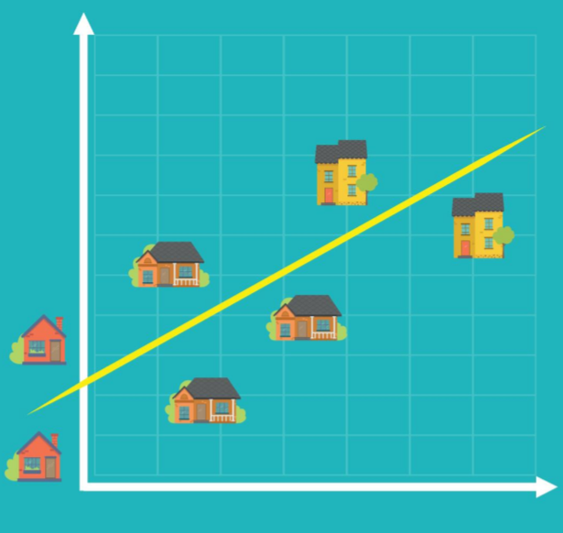
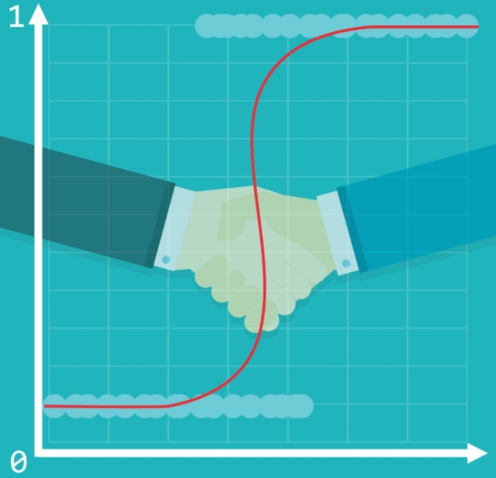
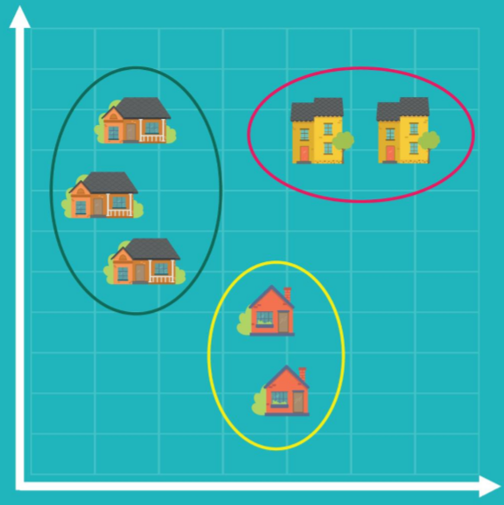
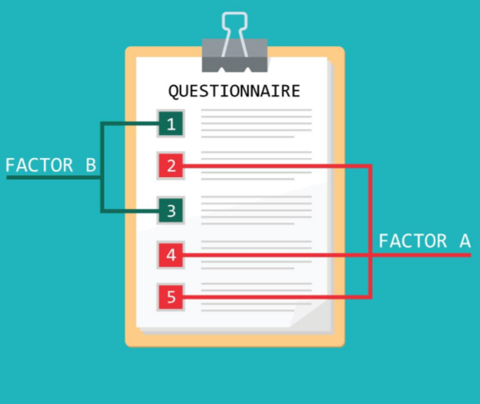
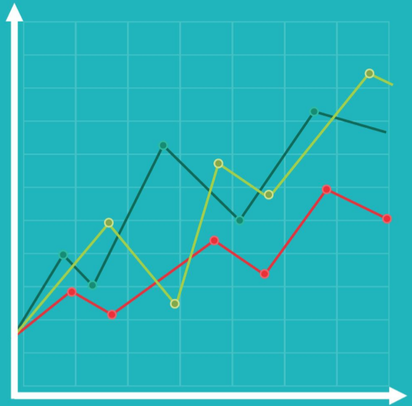
Traditional Approaches Some Overlaps with Machine Learning ….
Linear Regression
Logistic
Regression
Cluster Analysis
Factor Analysis
Time Series Analysis
Identifies the causal relationships amongst different variables
E.g. House price influenced by neighbourhood, house size, age, etc
Overcomes relationships that cannot be described linearly as 0 and 1
I.e. Filtering job candidates and how successful they will be in the first year (E..g > 50% success then 1 otherwise 0)
Exploratory approach where observations in the data form groups according to a categorisation
E.g. House price cost in-relation to size and location to a major centre (Downtown)
Like Cluster Analysis but focused on features rather than observations
E.g. if in a 100-item questionnaire every 10 questions pertains to a single attitude, factor analysis will identify the 10 factors. These can then be used for a regression, to provide a more interpretable prediction
Widely used in finance and economics, used for following values over time.
E.g. Tracking stock price changes over time, where time is presented horizontally

Slide 3
How Does It Work?
y = m * x + b
m¹
m & b are the only values available to train/adjust – no other way to affect the line
** There can be many lines **
m²
[
Weights
]
[
Biases
]
m^{1,1}
m^{2,1}
m^{3,1}
,
,
,
m^{1,2}
m^{2,2}
m^{3,2}
b^{1,1}
b^{2,1}
b^{3,1}
,
,
,
b^{1,2}
b^{2,2}
b^{3,2}

Slide 4

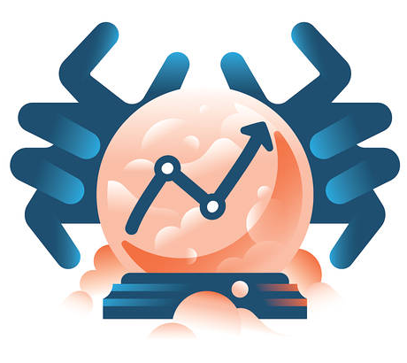
The Training Process (Supervised ML)
1
We use random values for W & B, making sure not to bias one state over another
2
We compare the output with what we expect it to have produced. We update W & B and Test again. As training progresses, M (the line) moves closer to identifying the correct separation between attributes
Training Data “Labelled Data”
[
Weights
]
[
Biases
]
m^{1,1}
m^{2,1}
m^{3,1}
m^{1,2}
m^{2,2}
m^{3,2}
b^{1,1}
b^{2,1}
b^{3,1}
b^{1,2}
b^{2,2}
b^{3,2}
,
,
,
,
,
,
3
Now we use Evaluation to see if the Model is any good. Use data that wasn’t used for training
Model
Prediction

Slide 5
Types of ML & Algorithms
Types
Supervised
Un-Supervised
Semi-Supervised
Reinforcement
As experts we act as the teacher, feeding the computer with training input “labelled” data and share the correct answer
Supervised learning algorithms try to model the relationships and dependencies between input features and target prediction
The computer is trained with unlabelled data
There is no teacher, the computer learns the patterns and is useful when there is no data expert
Algorithms focus on mining for rules, detecting patterns and summarising/grouping data points to derive meaning
Useful for when only some of the observed data has labels
These algorithms exploit the idea that even though group membership of unlabelled data is not known, the data includes important information about the group parameters
Similar to Supervised learning, where mapping is used between input and output, with this method the agent learns by trial and error using feedback from its own actions and experiences
Overview
Nearest Neighbour
Naïve Bayes
Decision Trees
Linear Regression
Support Vector Machine
Neural Networks
K-Means Clustering, Association Rules
Pseudo-Label
Ladder Networks
Q-Learning
Temporal Difference
Deep Adversarial Networks
Algorithms

Slide 6
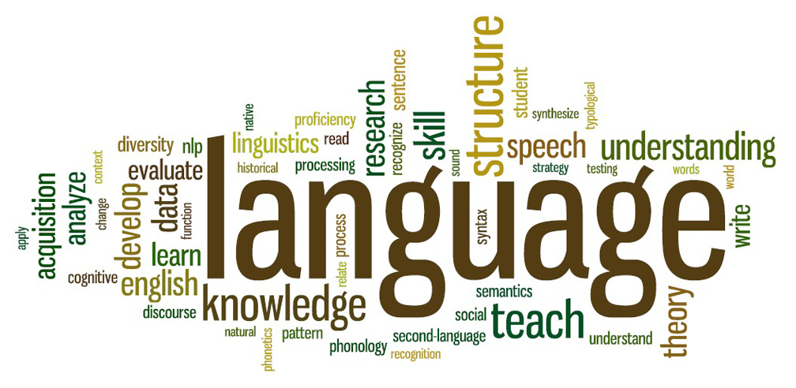
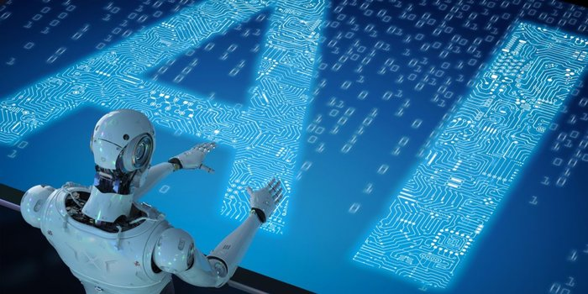
Natural Language Processing (NLP)
Sub-field of Artificial Intelligence
Understand and Process Human Languages and Generate Speech
Enable computers to get close to how Humans use Language
It’s not easy, they do not have Intuition, they cannot understand what the language is trying to say
Deep Learning Advancements – Translation, Summarisation & Semantic Understanding

Slide 7
How does it Work?
Natural Language Processing (NLP)
Natural Language Understanding (NLU)
Natural Language Generation (NLG)
Convert
Decompose
Understanding
Translate
Speech
Speech recognition (Hidden Markov Model)
Statistical models to determine what was said
Compare 10-20ms segments
Called “Part-of-Speech Tagging” (POS)
Understand the meaning of each word, is it a noun, verb, past-tense, etc
Lexicon and grammar rules
Statistical Machine Learning (ML)
Challenges with Polysemy and Synonymy
What information to translate?
Results of a query, organised into a structure of what it wants to say
Reverse of NFU, lexicon and grammar rules to author sentence
The engine can now use the nuances of the audience to communicate back to the human
If vocalised, a text-to-speech engine will take over

Slide 8
NLP & Language
Intents
Entities
Model
Utterances
Specific to Chatbots, represents the words that describe the intention of a piece of sentence, for example an action word like “Show”
A real-world-object that is assigned a name, for example a person, a country, a product or a book title
The process of training a Machine Learning (ML) model involves passing training data to a learning algorithm. The model is the output of the training process and is used to get predictions on new data, which you do not know the target
Anything that is said, for example “what hotels are within 3 miles of London Heathrow airport”

Slide 9

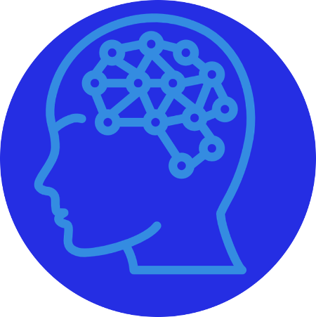


Chatbot Demo: How does it Work?
Natural Language Processing (NLP)
Natural Language Understanding (NLU)
Natural Language Generation (NLG)
Decompose
Understanding
Translate
Speech
Via the emulator, the Chatbot receives the text over HTTP
The Bot sends the text to the NLP engine via a REST endpoint
The text meaning is returned to the Bot where it is translated into a response
The Bot presents the response back to the user

Slide 10
Demo
Revisit Iris Supervised Machine Learning

Slide 11

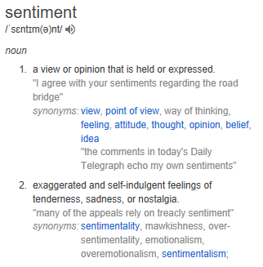



A More Complex Example Sentiment Analysis on Movie Reviews
Human Language is Complex!
Positive
Negative
Sarcasm
Angry
Sad
Proud
Neutral

Slide 12
Demo
Sentiment Analysis of Movie Reviews

Slide 13
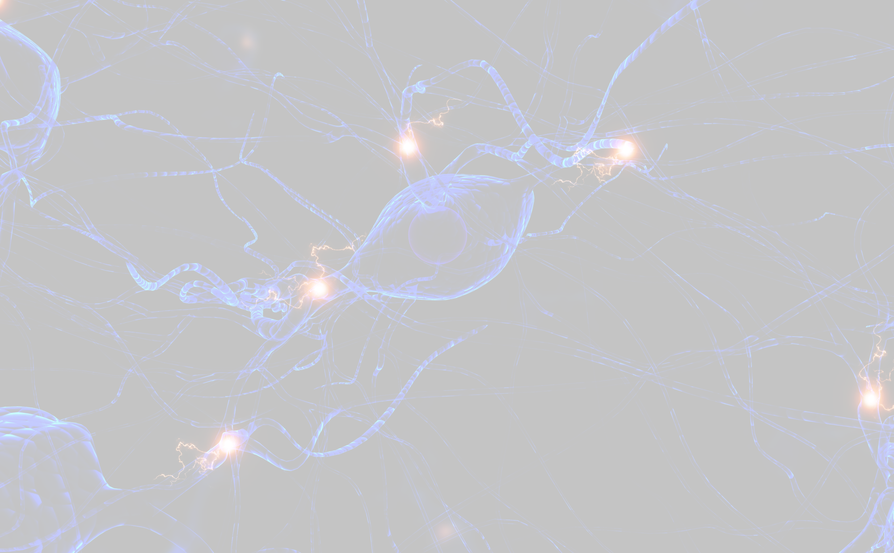
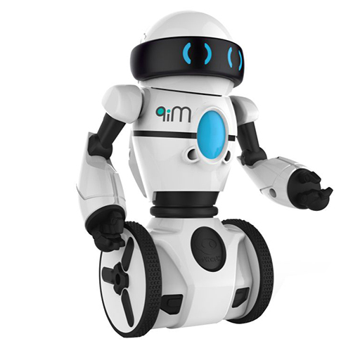
Reinforcement Learning
Observe
Autonomous & Self-Teaching
Learn by Trial & Error
Perform an Action to Gain a Reward
Cyclic, Fine-Tune Actions
Re-working and Modifying Algorithms Autonomously Until it Makes Best Decisions, Best Result
Reward
Action

Slide 14
Demo
Learn Like a Human – Balancing a Stick

Slide 15
Thank you

